Slide 1
Agriculture
SMART FARMING SENSOR DATA FOR YIELD PREDICTION
Presented by
DIYA PATEL

Slide 2
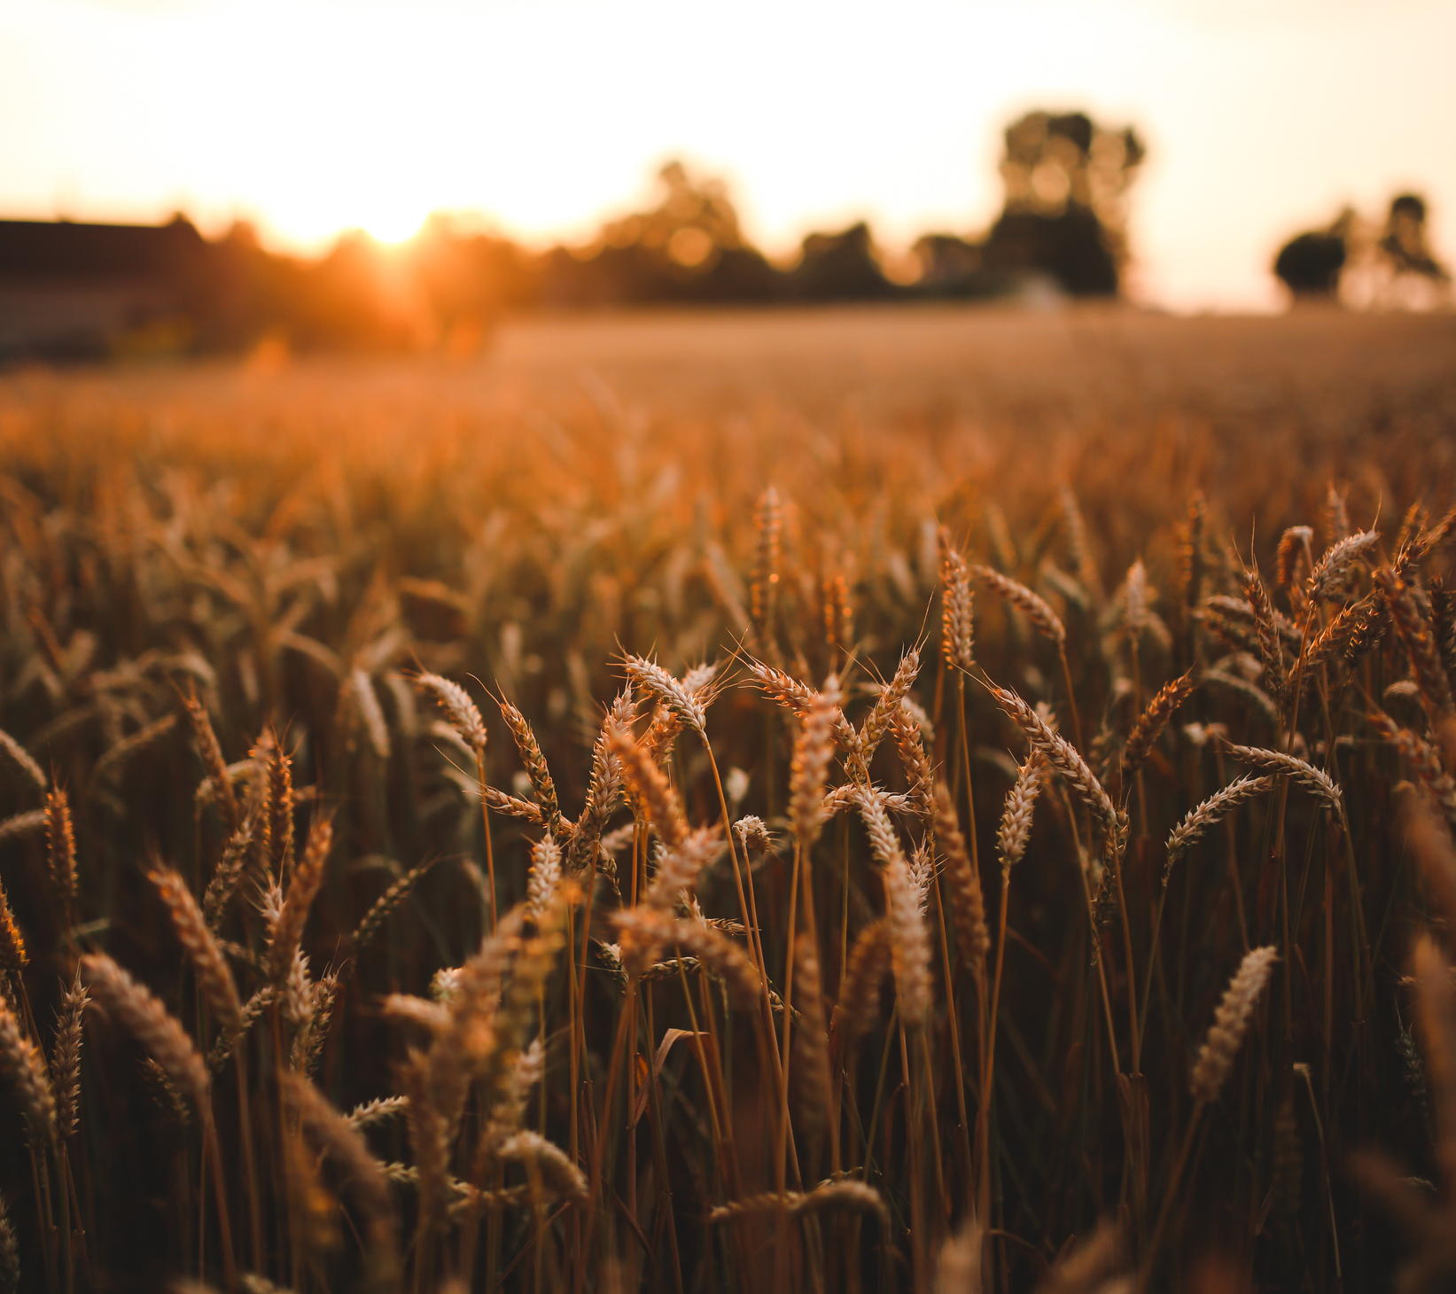
OUR PURPOSE
This Power BI dashboard is designed to analyze the relationship between farming practices and crop yield efficiency using sensor-driven smart farming data. By leveraging data on fertilizer usage, irrigation methods, sowing-harvest timelines, and disease status across 500 farms worldwide, the dashboard aims to uncover actionable insights that support data-driven agricultural decisions. It empowers stakeholders to evaluate which practices lead to optimal yield efficiency, monitor crop health trends, and identify patterns that can enhance sustainable and productive farming systems.
02

Slide 3
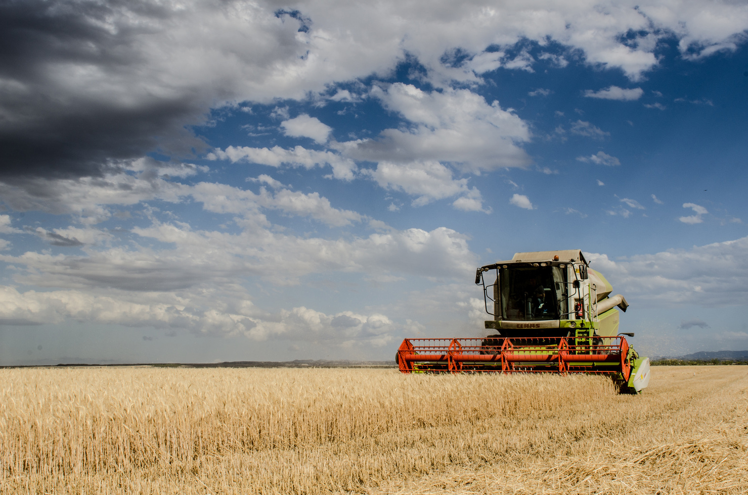
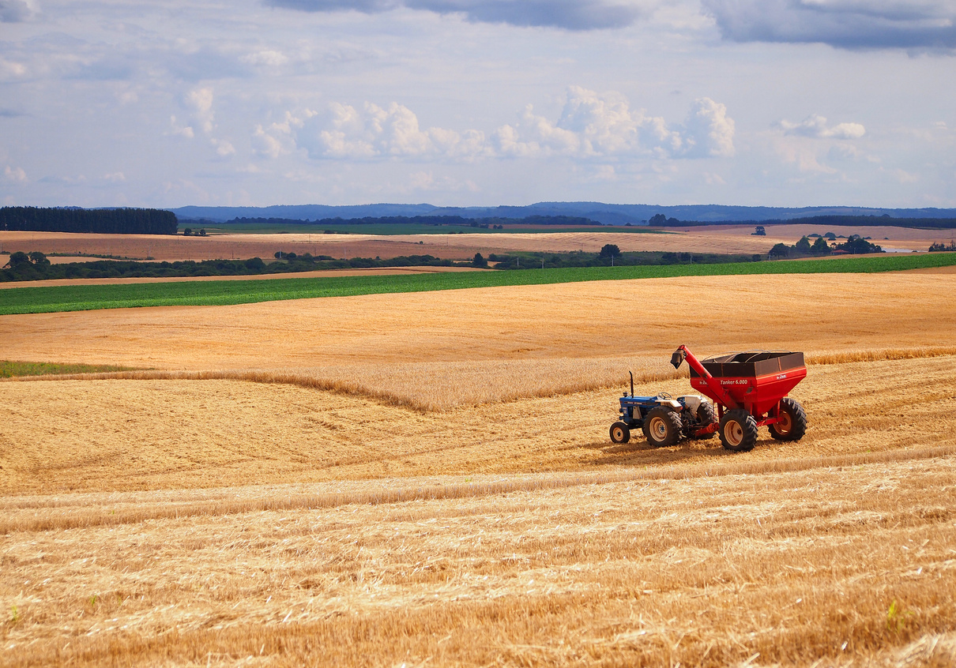
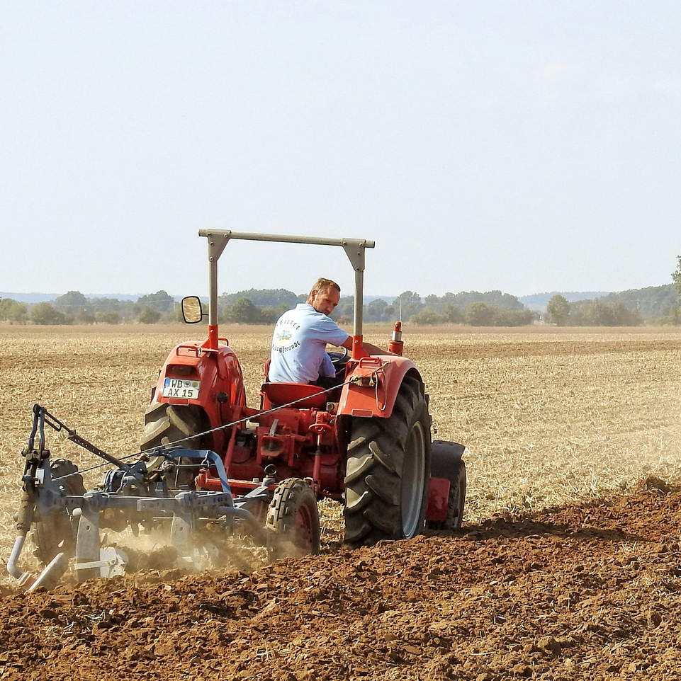
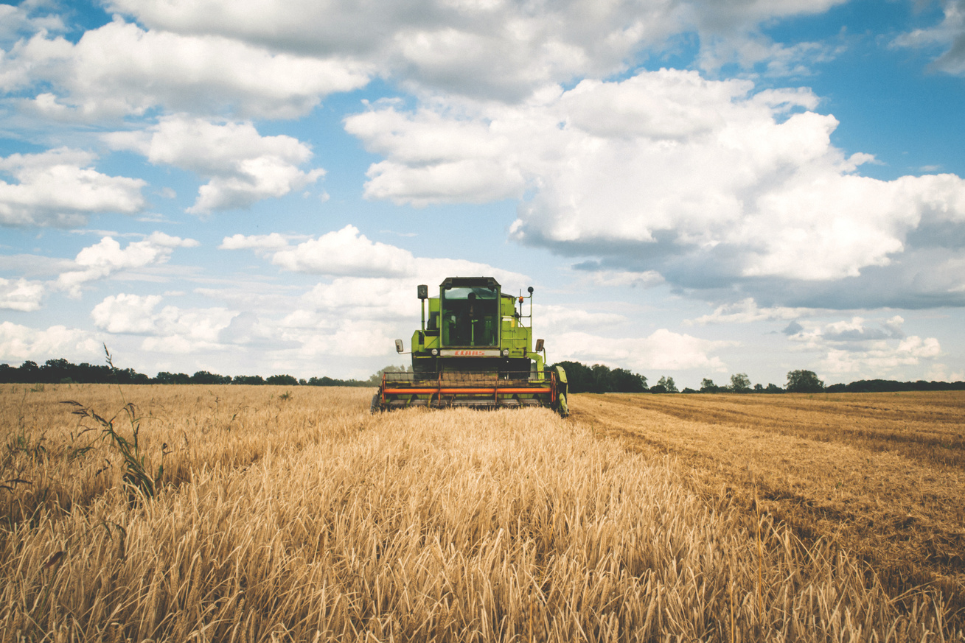
Our Objectives
01
Measure Average Yield Efficiency
Calculate and analyze the average yield per day (yield_kg_per_hectare / total_days) to evaluate farm productivity.
02
Analyze Fertilizer Impact on Yield
Compare the yield efficiency achieved through different fertilizer types (Organic, Inorganic, Mixed) to identify the most effective practices.
03
Compare Irrigation Methods
Evaluate how various irrigation techniques (Drip, Sprinkler, Manual, None) influence crop yield efficiency and resource usage.
04
Explore Yield Trends Over Time
Track yield performance from sowing to harvest to uncover seasonal or time-based productivity patterns.
05
Assess Crop Disease Distribution
Identify the prevalence and severity of crop diseases (None, Mild, Moderate, Severe) across farms to support preventive measures and healthier crop growth.
03

Slide 4
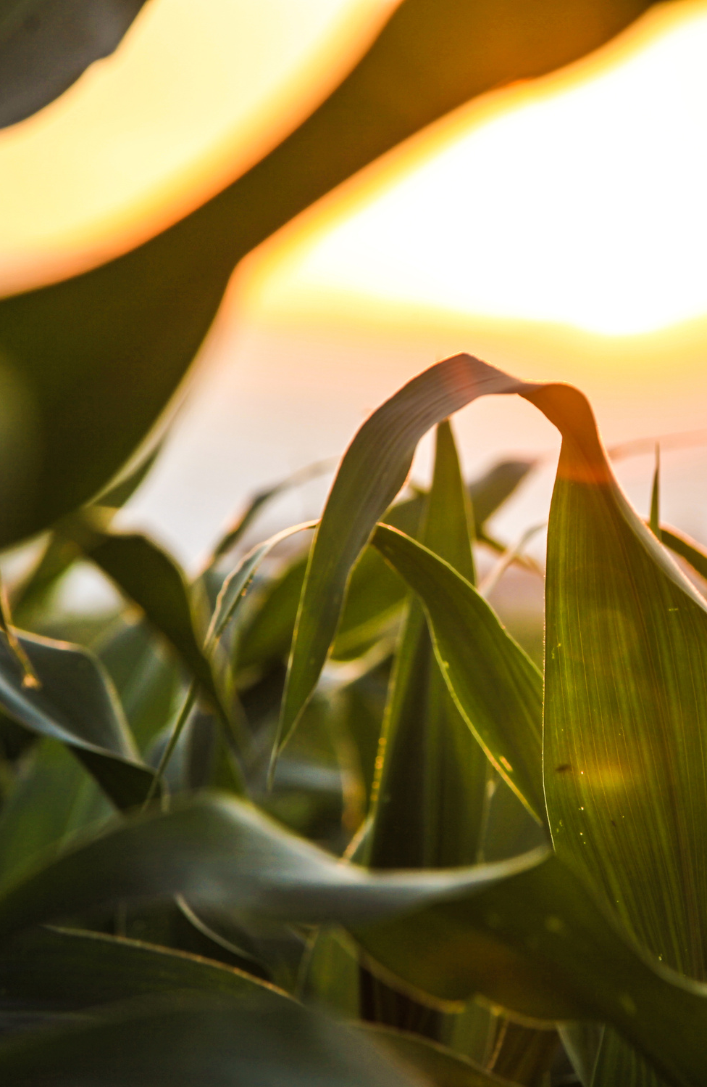
KEY QUESTIONS
01
What is the average yield efficiency across all smart farms?
Which fertilizer type contributes most to total crop yield?
02
Which irrigation method leads to the highest yield efficiency?
03
Which irrigation method leads to the highest yield efficiency?
04
What is the distribution of crop disease status across different crop types?
05
04

Slide 5
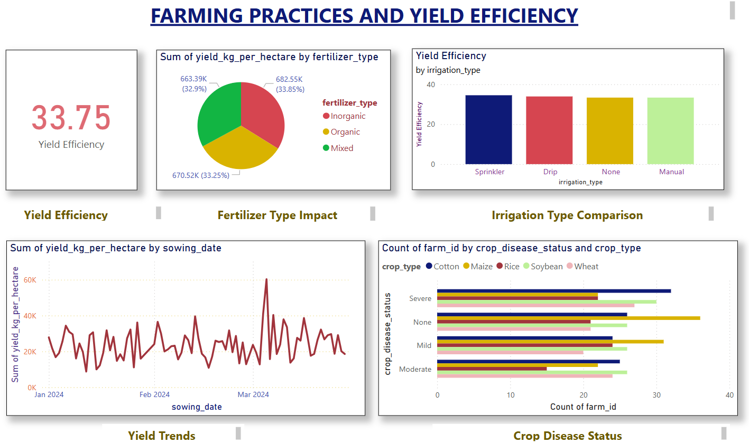

Slide 6

CONCLUSION
The "Farming Practices and Yield Efficiency" dashboard reveals that the overall average yield efficiency across farms is 33.75 kg per hectare per day. Among fertilizer types, Inorganic fertilizers slightly outperform Organic and Mixed types in total yield contribution. Sprinkler irrigation shows the highest efficiency compared to Drip, Manual, and even no irrigation, suggesting its effectiveness in boosting yield. Yield trends over sowing dates show fluctuations with occasional peaks, indicating seasonal or operational influences. Additionally, the crop disease analysis shows that all crop types experience varying levels of disease, with Wheat and Maize showing higher counts in severe and moderate categories, emphasizing the need for disease-specific crop management strategies.
06

Slide 7
Thank You

